Slide 1
Capstone Project (Background and Objectives) MARKETING ANALYTICS

Slide 2

Background
Client
A leading FMCG company of XXX which manufactures and sells a host of products like Biscuits , Coffee , Juice , Chocolates and many more .
Background
The company has PAN country business in 7 brands of following product Categories
B1 : Coffee
B2 : Biscuits
B3 : Juice
B4 : Chocolates
B5 : Ice cream
B6 : Bottled water
B7 : Baby food
The company launched a new flavor variant of coffee brand in January 2023. The marketing campaign was executed for their Channel Partners and end consumers before the product launch

Slide 3
Background
For Channel Partners, the company introduced the product and reward system through SMS, email and call.
For end consumers, product samples were given and initial opinion was understood through primary market research
Objective
The objective of the study was three-fold
To identify which Channel partners responded and who to target first in the next planned campaign
To identify the most effective communication channel/s for them
To analyze the responses collected from end consumers and see if minor tweaks can be done to improve the product

Slide 4
Background
Data
The following data is available for analysis:
Channel partners: Transactions of the Channel partners two years prior to the campaign
Channel partners: Campaign Details
Channel partners: Campaign Response Data
Channel partners: Master Lookup
Consumer: Responses about new coffee flavour

Slide 5

Understanding the Channel partner Data

Slide 6
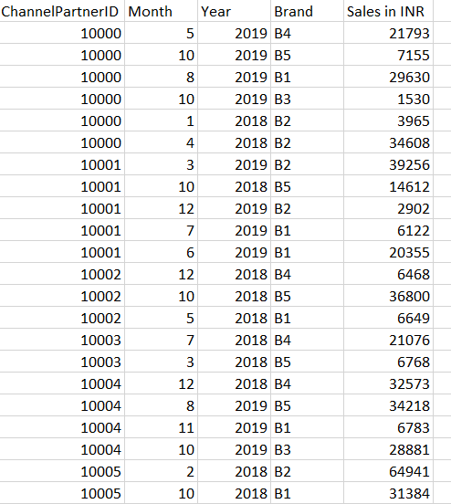
Channel partner Information : Transaction Data
Content
Transaction data of all 90,000 Channel partners for the company . (2021 and 2022)
500,000 transactions to describe the transaction details of each Channel Partner by "Month" and "Brand"
Columns | Description | Type | Measurement | Possible values
Channel partnerID | Channel partner’s ID | numeric | - | -
Month | Month | factor | - | 12
Year | Year | factor | - | 2018, 2019
Brand | Brand | factor | - | B1, B2, B3, B4, B5, B6, B7
Sales | Sales done | numeric | - | Positive numbers

Slide 7
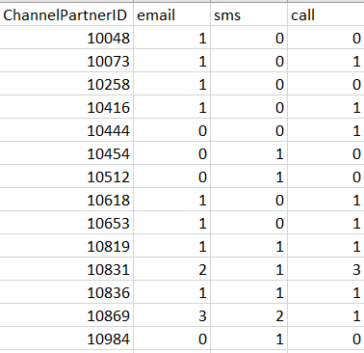
Channel partner Information : Campaign Details Data
Content
Campaign was run in January 2023 for the new variant in Brand 1 : Coffee
Sample Size : 1228 Channel partners’ campaign communication data to describe which Communication channel was used to contact them
Columns | Description | Type | Measurement | Possible values
Channel partnerID | Channel partner’s ID | numeric | - | -
email | No. of emails | integer | - | Positive numbers
sms | No. of sms | integer | - | Positive numbers
call | No. of calls | integer | - | Positive numbers

Slide 8
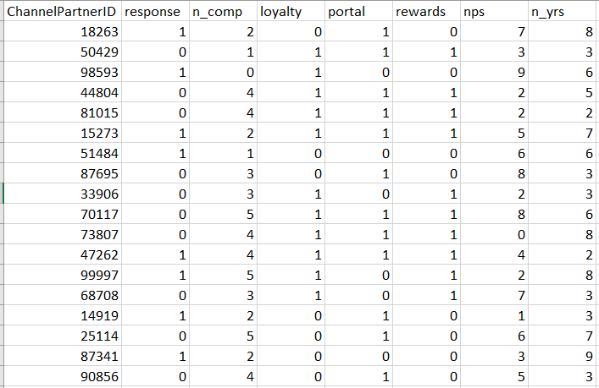
Channel partner Information : Campaign response Data
Content
The response of the 1228 Channel partners for the Campaign is captured .
Sample Size : 1228
Columns | Description | Type | Measurement | Possible values
Channel partnerID | Channel partner’s ID | numeric | - | -
response | Customer’s response to campaign | factor | - | 1 = responded 0 = Did not respond
n_comp | number of complaints in last 3 months | integer | - | Positive values
loyalty | member of loyalty program(Yes=1) | factor | - | 0,1
portal | active on web portal(Yes=1) | factor | - | 0,1
rewards | Redeemed reward points last month(Yes=1) | factor | - | 0,1
nps | Net Promoter Score | integer | - | 0-10
n_yrs | number of years in business with the company | integer | - | Positive values

Slide 9
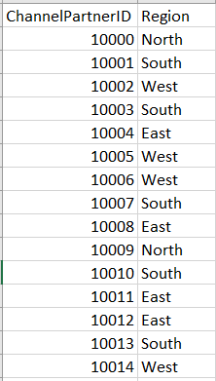
Channel partner Information : Master lookup Data
Content
Region of business for each of 90,000 Channel Partners
Columns | Description | Type | Measurement | Possible values
Channel partnerID | Channel partner’s ID | numeric | - | -
Region | Region of customer | factor | - | East, North, South, West

Slide 10


Understanding the Consumer/ End user Response

Slide 11
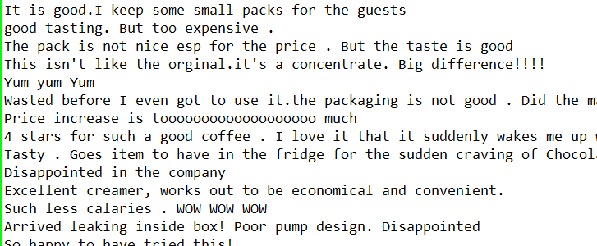
Consumer Information : Responses
Content
The response of consumer after a week of the samples given out were captured
Sample Size : 74
Description | Type
Consumer Responses | text

Slide 12




Next steps
Data management
Descriptive Statistics
& Data visualization
Predictive modelling
Text mining
Understanding the data better like checking responses region wise , region wise actively engaged Channelpartners etc.
How can this data be presented better visually ?
Understand the customer responses using various Text mining Techniques
Answer the objective: To analyze the responses collected from end user and see if minor tweaks can be done to improve the product
Compile all 4 data files based on Channel partner ID of 1228 Channel partners who have taken part in the campaign.
Data cleaning , Handling missing values and completing Basic Data checks
Create variables other than existing data variables. For ex, Brand engagement : How many brands does each Channel partner buy in a particular year
Answer the objectives a)To identify which Channel partners responded and who to target first in the next planned campaign b)To identify the most effective communication channel/s for them
Using different Predictive model techniques to find Significant variables
Ensure you follow all steps like Train and test data , checking for Multicollinearity
Check if any other ML technique fits better
* You can go through the Questions and Hint ppt to understand each section better / cross check if you have done all the steps mentioned

